Slide 1

5th NOWPAP Remote Sensing Training Course 2021
Webinar 2: Monitoring and Assessment of Water Quality by Ocean Color Remote Sensing

Slide 2
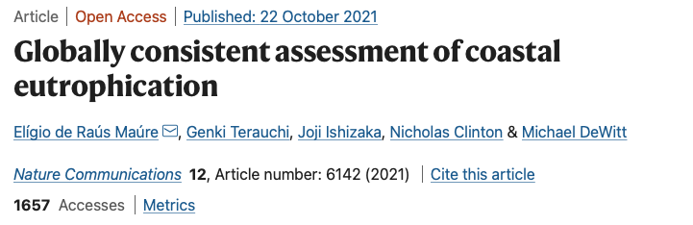
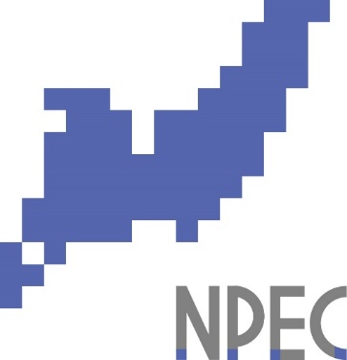
Eligio Maure
Northwest Pacific Region Environmental Cooperation Center
Notes:
Hi everyone
Today I introduce a globally consistent assessment of coastal eutrophication in Google Earth Engine

Slide 3
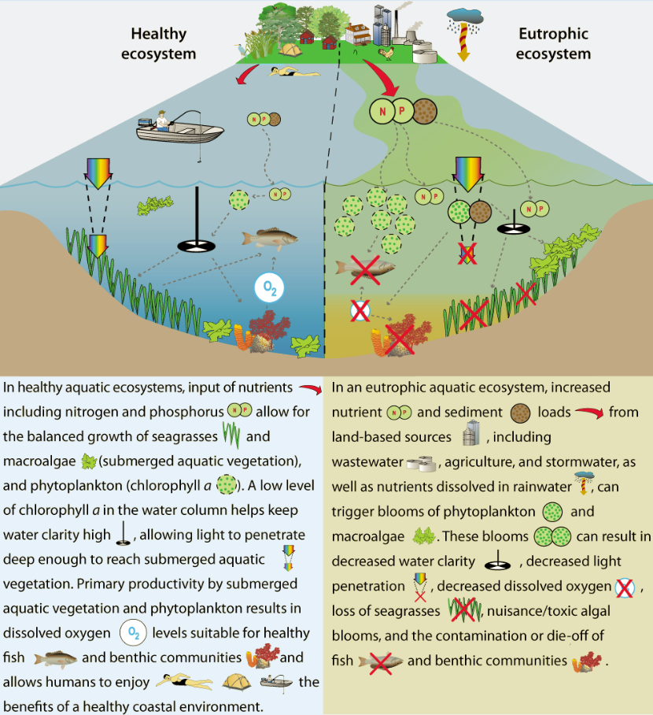
Coastal Eutrophication
Also known as cultural eutrophication: accelerated degradation of coastal ecosystems associated with increasing anthropogenic nutrient loading.
High Nutrients loads (industrial & household)
Red Tide (Harmful Algal Blooms)
Low Bottom Oxygen (Hypoxia and anoxia)
Low Transparency (Less submerged vegetation)
Global Coastal Problem
SDG 14.1.1a: (Index of coastal eutrophication)

Slide 4
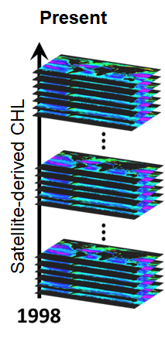
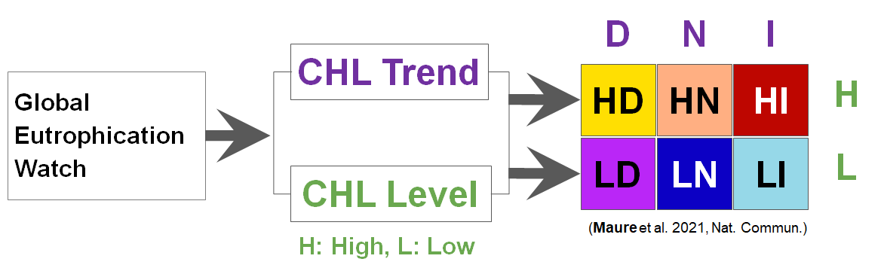
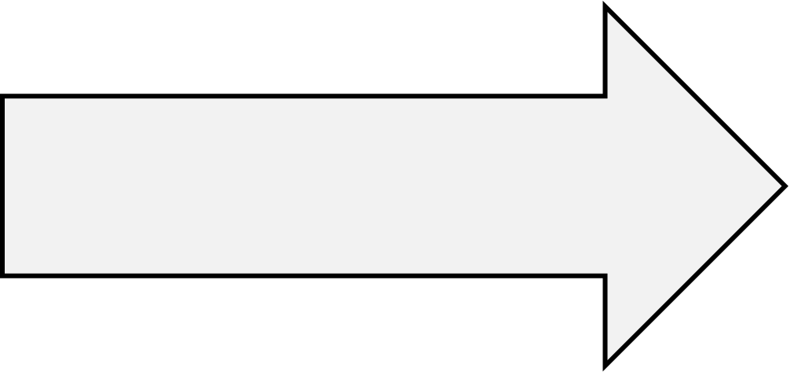
Global Eutrophication Watch
A planetary scale tool for eutrophication assessment
Global Eutrophication Watch: a Google Earth Engine tool for coastal eutrophication assessment using the NEAT methodology
It detect symptoms of coastal eutrophication using only satellite-derived chlorophyll-a (CHL) concentration
Eutrophic potential waters: HD, HN and HI
Eutrophication potential waters: HI and LI
NOWPAP: Northwest Pacific Action Plan
NEAT: NOWPAP Eutrophication Assessment Tool (Terauchi et al. 2014, 2018)
Notes:
Here, we introduce the global eutrophication watch, a planetary scale tool of coastal eutrophication.
This tool detects symptoms of eutrophication using satellite-derived CHL time series.
It detects trends and levels of CHL and associate them with eutrophication potential.
Here, D is associated with decreasing trends, N no trend and I increasing trends.
H is high CHL and L low CHL based on a given threshold.

Slide 5
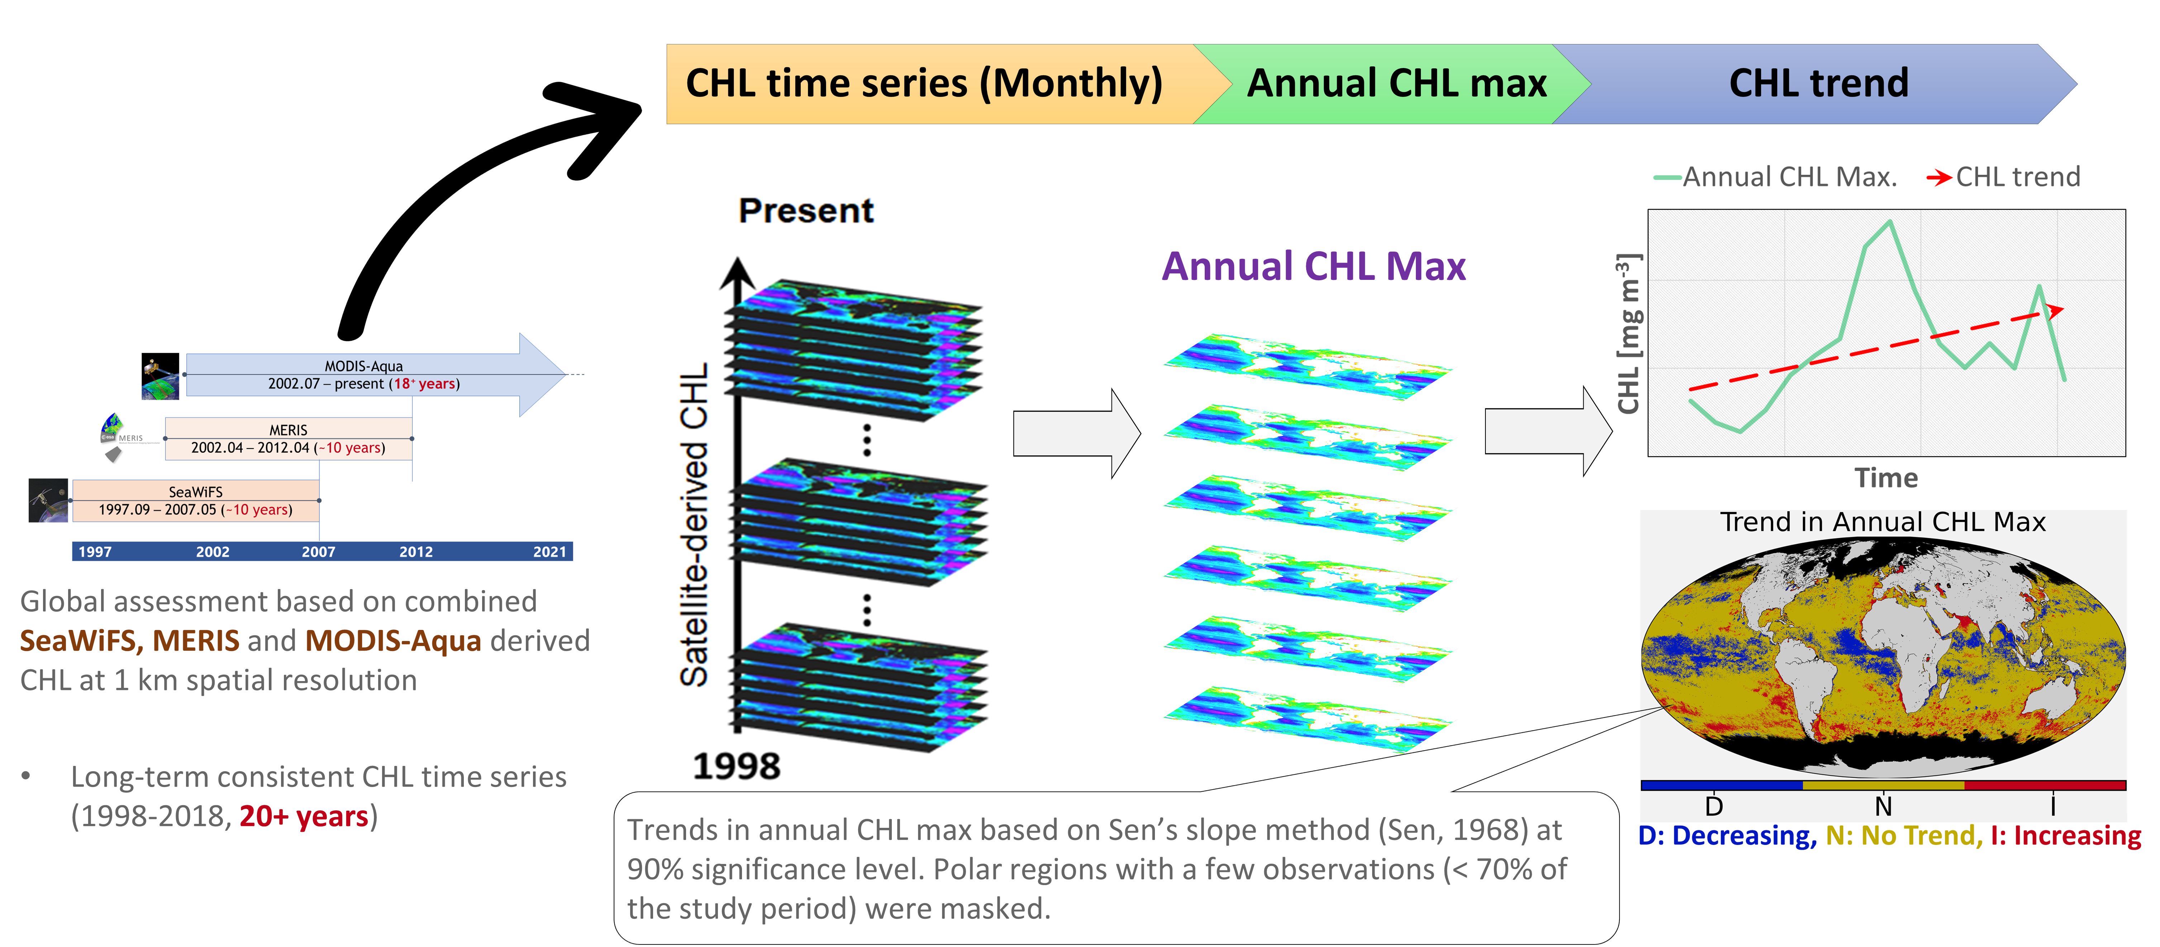
Global Eutrophication Watch: Trend in Annual CHL Max
Global assessment: MODIS-Aqua CHL data with 4 km spatial resolution
NOWPAP region: combined above three sensors at 1 km spatial resolution

Slide 6
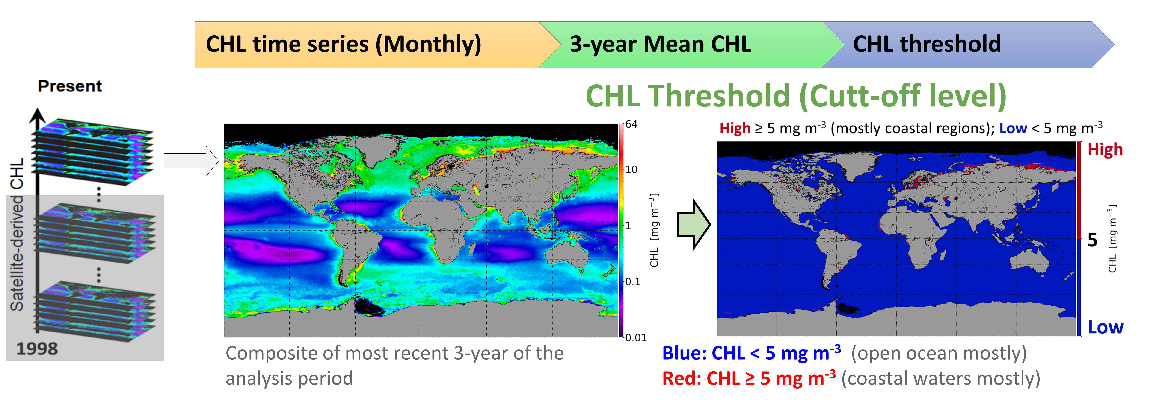
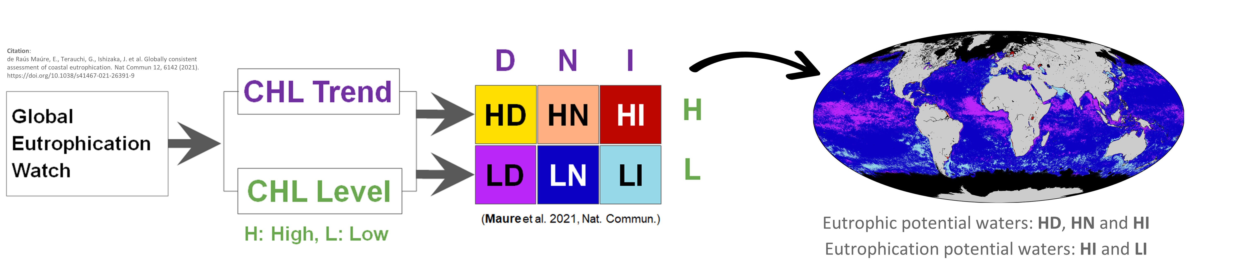
Global Eutrophication Watch: 3-year Mean CHL

Slide 7
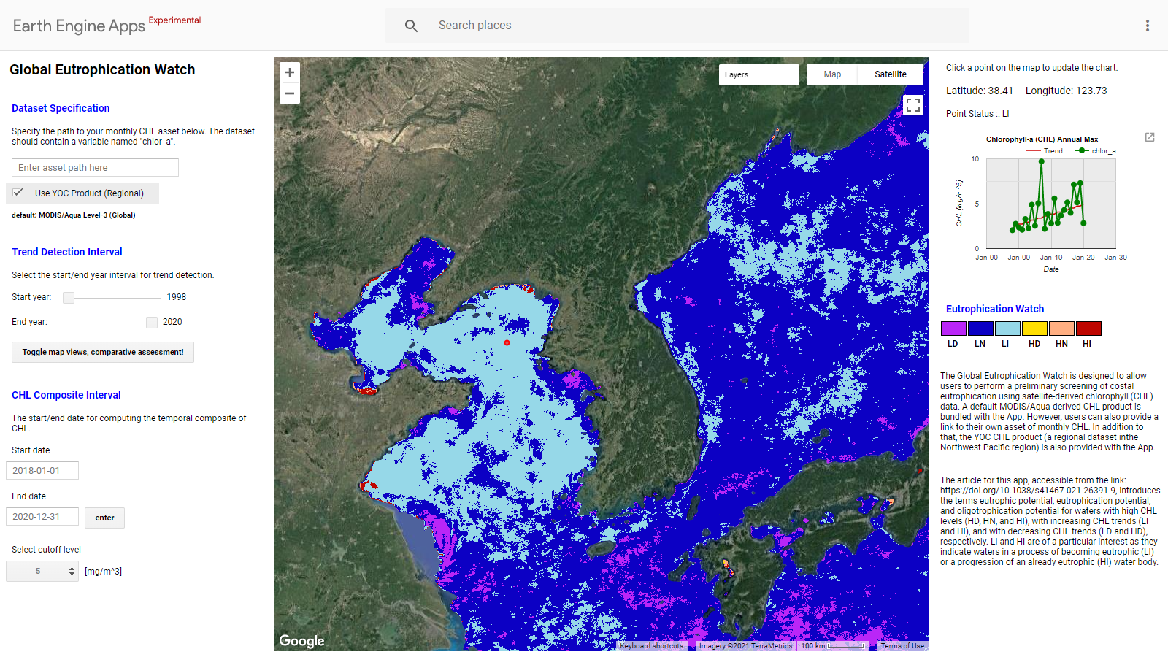
The Global Eutrophication Watch App: Global Assessment
Fields in the App
Specification of dataset for eutrophication assessment
Definition of assessment interval for trend detection
Definition of chlorophyll (CHL) level parameters (CHL threshold)
Eutrophication assessment map
Time series of a select point on the map
Assessment colour codes
1
5
2
6
4
3
EE App: https://eutrophicationwatch.users.earthengine.app/view/global-eutrophication-watch
Notes:
This is the screenshot shows the GEE-based GEW. The app can be accessed using the link on top.
On the left we have the app’s control panel where users can select the dataset for assessment, the period of assessment and the CHL threshold.
In the middle we have the assessment map and on the right the time series of a select point in the map and the six colour classes

Slide 8
The Global Eutrophication Watch App: Regional Assessment
Eutrophication assessment in NOWPAP region using a regional dataset
The dataset is based on a local algorithm developed to improve CHL retrievals in coastal regions highly influenced by coloured dissolved organic matter and suspended sediments (Siswanto et al. 2011)
https://eutrophicationwatch.users.earthengine.app/view/global-eutrophication-watch

Slide 9
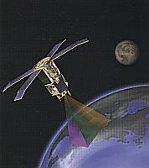
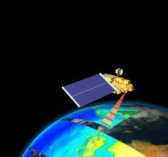
Regional Satellite-derived CHL in the NOWPAP
Satellite Sensors
SeaWiFS (1998-2007)
MERIS (2002-2012)
MODIS-Aqua (2002-present)
YOC and NASA Standard mixed for Case 2 water
NASA Standard
for case 1 water
Algorithm to estimate chlorophyll-a
NASA Standard
Yellow Sea Large Marine Ecosystem
Ocean Color Project Algorithm (YOC)

Slide 10
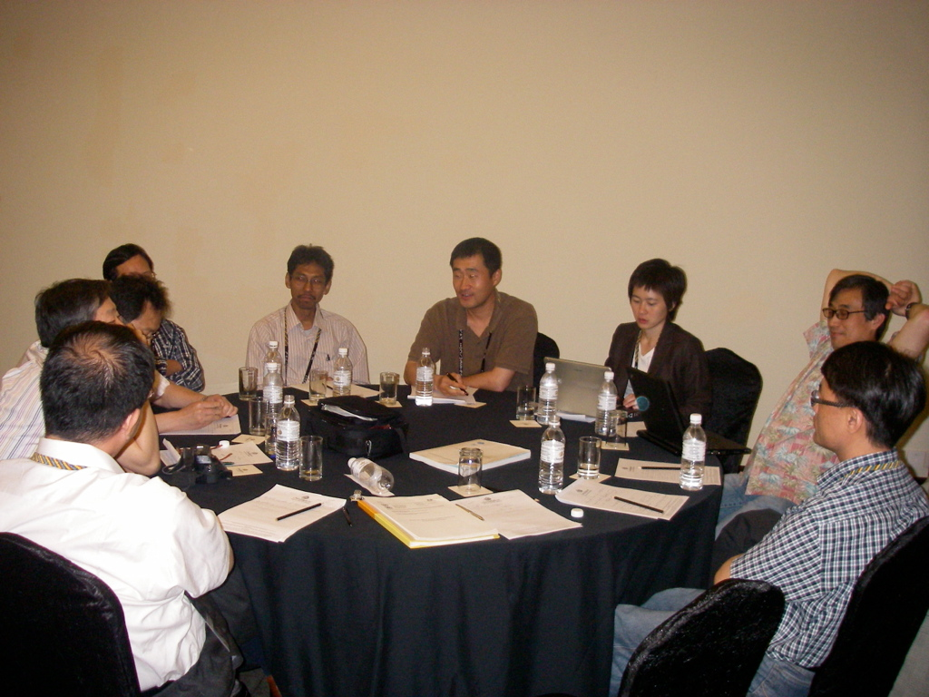
Regional efforts to improve satellite derived CHL

Slide 11
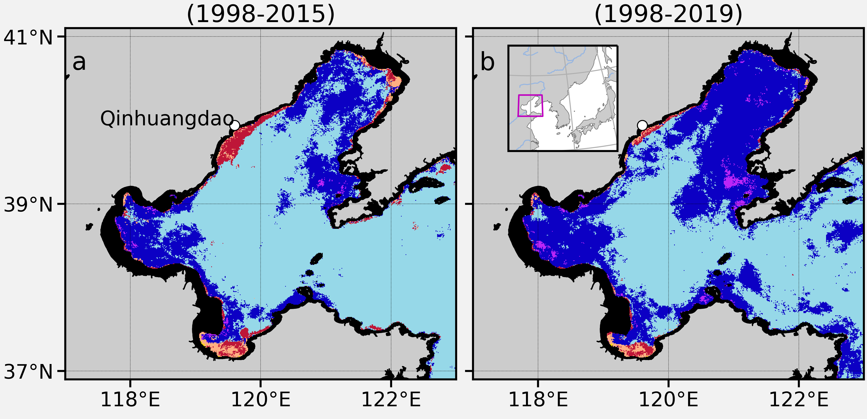
Regional Satellite-derived CHL in the NOWPAP
Highlights improving water quality with decreasing CHL trends

Slide 12
SGLI data ingesting in Google Earth Engine
Ingested SGLI level 2 mapped CHL data from EORC (https://code.earthengine.google.com/a93ee099b1a13cc298227bc4f7e2b81d)
Ingestion of SGLI level 2 swath data tested by NPEC
Ingestion of SGLI level 2 swath data to be done by the Google soon

